Slide 1
Current Status of YouTube Simulation
January 9th, 2024
Sasha Rabeno

Slide 2
What does it do now?
Generates flexible number of agents and videos, in accordance with archetype parameters/distribution.
Runs simulation of video-watching for four different recommendation algorithms:
No system
Filtered list
Filtered list with 10% chance of watching an entirely random video
Scoring system
Graphs the following for each system, w/ side-by-side regression curves to compare between systems:
Avg. extremeness of videos watched per agent
Minutes watched per agent (by both extremeness and agent #, which in this case correlate)
Number of videos watched per agent

Slide 3
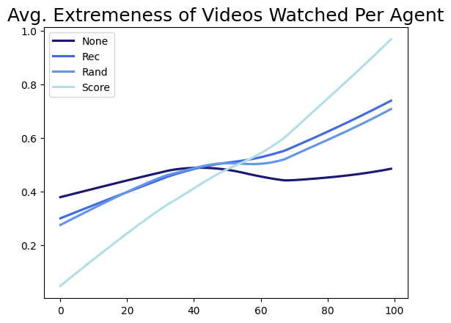
Avg. Extremeness of Videos Watched Per Agent

Slide 4
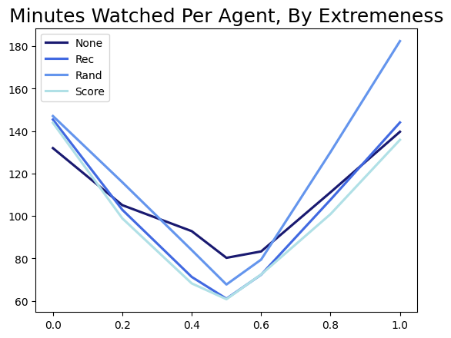
Minutes Watched Per Agent, By Extremeness
Make y axis extremeness of videos watched
Make x axis the longest video threshold, or yt time threshold, or pop threshold
- > each of the other parameters, one graph at a time
If you’re switching to generate random, non-archetype agents, sort the agents by extremeness on x-axis and see what their watched extremeness is on y-axis. Etc.

Slide 5
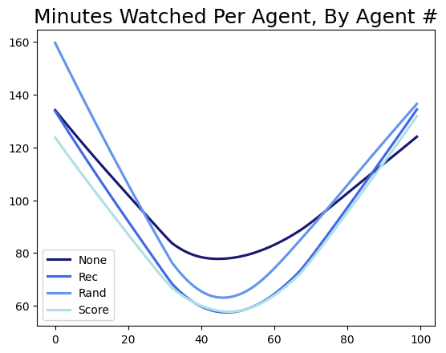
Minutes Watched Per Agent, By Agent #

Slide 6
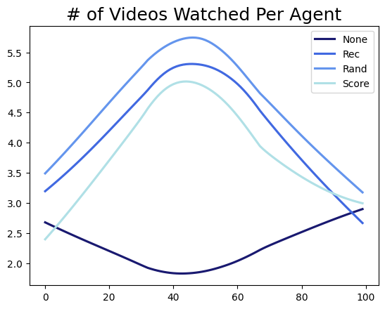
# of Videos Watched Per Agent

Slide 7
What does the simulation currently show?
Average extremeness of videos watched goes up for each of the rec systems. This effect is much more pronounced in the scoring system.
Agents on the extremes watch more minutes of content with the rec systems than without. However, agents in the middle watch less minutes of content with the rec systems.
For every rec system, users watch a higher quantity of videos, with those in the middle having the highest increase in number of videos watched.
Despite the middle agents watching more videos, they’re watching for less time. This makes sense---the middle agents prefer shorter videos, so they’re likely watching a bunch of really short videos.

Slide 8
What are potential next steps/research questions to answer?
Look at how each system affects users in the middle and extremes separately, rather than just the overall averages
e.g. Find the averages for each graph for, say, just the middle three categories of agent, and see how what they watch changes for each system.
Mess around with the scoring system. Change around the parameters and the weights and such to see what can happen.
E.g. how do the results of the scoring system change depending on how the parameters change?
Try making the agents a lot more random
e.g. Generate however many agents, but instead of following a distribution for their viewing preferences and habits, all of their attributes are completely random. Disregard the archetypes entirely.
What would a normal person want to know from this work? What questions are we missing here?

Slide 9
Look at how each system affects users in the middle and extremes separately, rather than just the overall averages. Goal: see how more run-of-the-mill, not extreme users are affected by the different rec. systems.
Steps to do so:
Run simulation with just the agents in the middle three archetypes, aka the middle 56% of agents. Or, generate only agents in these three archetypes (might be easier).
"passive_liberal": 0.15,
"politically_disengaged": 0.26,
"moderate": 0.15,
Generate graphs, with averages like usual, for just these agents, instead of everybody.
Compare side-by-side how the numbers change for these middle agents.
If desired, repeat for just the extreme agents.

Slide 10
Look at how each system affects users in the middle and extremes separately, rather than just the overall averages.
Each graph is an x-y scatter plot. Let’s look at just the first part of the first graph, Avg. Extremeness of Videos Watched Per Agent.
x = numpy.arange(0, NUM_AGENTS)
y = Reverse(extr_of_each_agent_video_all)
How does this have to change? For 100 agents (to make my life easier), the range will be from 19 to 74 (so, the middle 56 agents). Thus,
x = numpy.arange(19, 74).
For y, extr_of_each_agent_video_all needs to lose values 0-18, and 75-99. We can make a copy of this array that’s just the middle 56 values. So, copy = extr_of_each_agent_video_all [19:74]. Therefore:
y = Reverse(extr_of_each_agent_video_all[19:74]), or Reverse(copy).

Slide 11
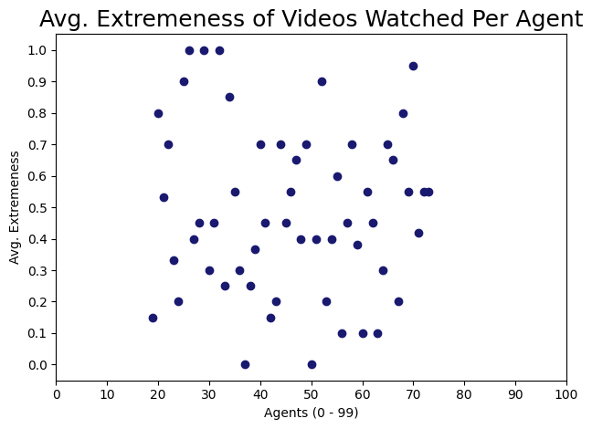
The previous slide’s work gives the following graph.
Let’s repeat this for the other systems in this particular graph.

Slide 12
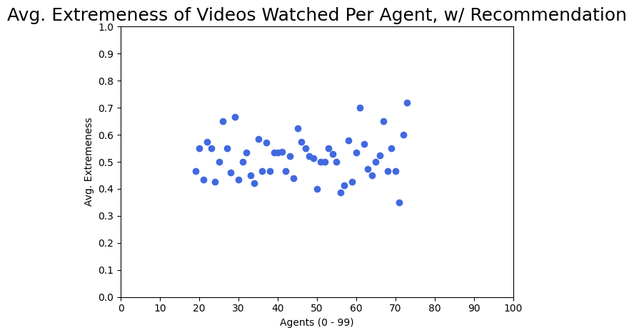

Slide 13
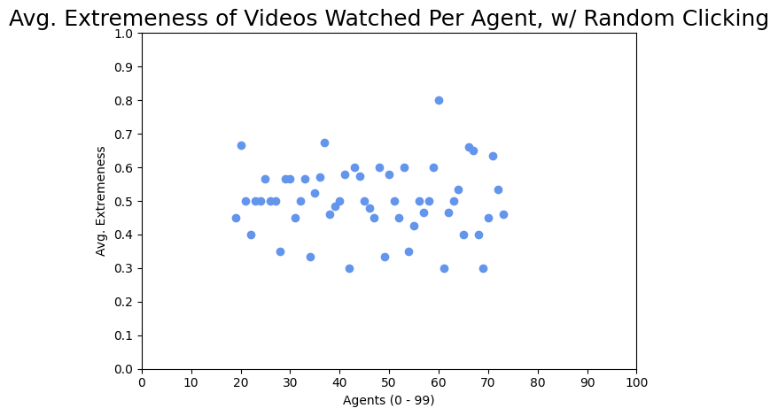

Slide 14
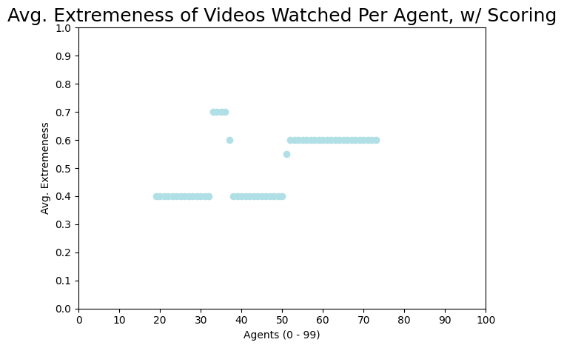

Slide 15
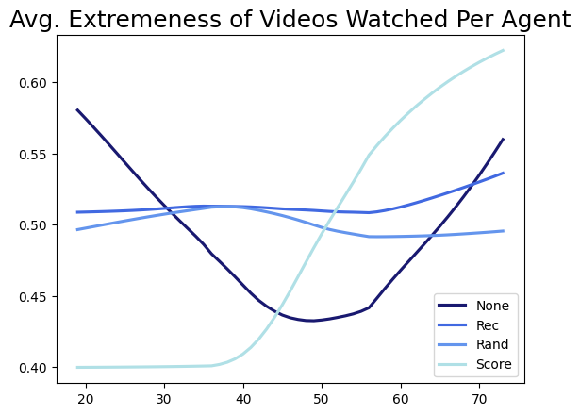
The final regression graph looks like this:
This isn’t super helpful without any numbers. But based on my rudimentary look at this, here’s what I can tell:
- The placebo pattern (no rec system) has extremeness of videos watched ranging from 0.43 to 0.58 (with those on the ends, aka not in the dead center, watching slightly more extreme videos.
- For the filtered list systems (rec and rand), the extremeness goes up for the lower users and down for the edge ones. Thus, the filtered list systems sort of “average out” the extremeness for this subset of users.
- For the scoring system, users’ preferences get more extreme! The slightly-left-wing users get recommended more left wing content, and same for the slightly-right-wing users. The middle sort of evens out, but has sharp jumps between users.

Slide 16
tl;dr from the last slide
Again, from what I am observing with my eyes (and not numbers), the filtered list systems (rec/rand) make users watch more middle-of-the-line videos regardless of their own preferences, while the scoring system makes users watch more extreme content. Neat stuff!
Remember that “users” here is just the middle 56% of all the overall users, AKA those who fall into one of the three middle archetypes. Thus, this graph shows that these more run of the mill users are watching incredibly average content with the filtered lists, but are pushed to more extreme content with the scoring system.

Slide 17
Why is this important?
The scoring system was my attempt to get as close to what YouTube does as possible (since I am 99% sure they use a weighted scoring system as well---I have a paper somewhere that confirms this). Thus, the fact that the scoring system (aka more accurate YouTube simulation) makes users watch more extreme content sort of answers our chief research question: do recommendation algorithms push users to watch more extreme content than they normally would? For this case, we can say yes!
The graph on the right is effectively a really zoomed in version of the shaded region of the overall graph on the left.

Slide 18
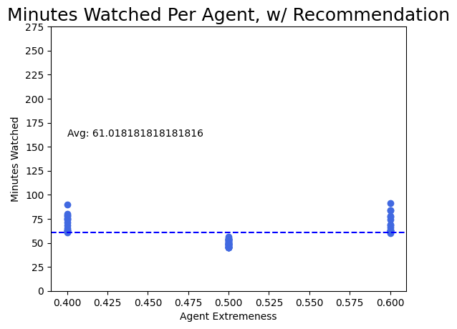
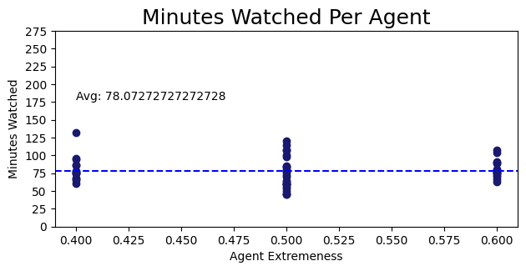
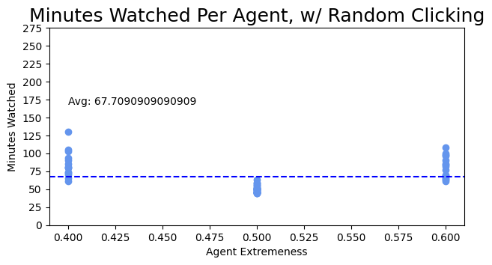
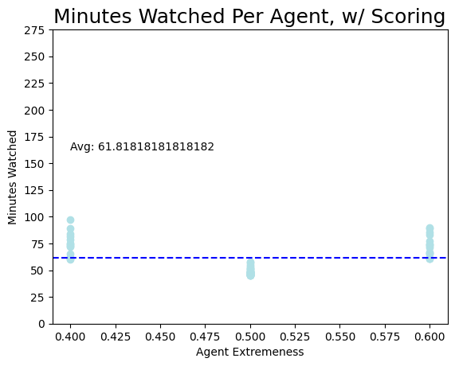
Middle Agents Minutes Watched

Slide 19
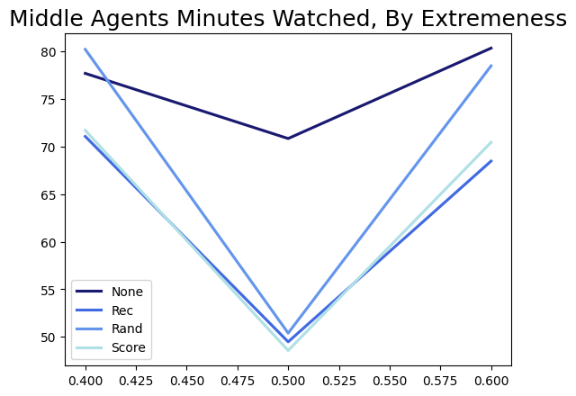
Minutes Watched Cont’d.
No system: 78.072 minutes
Filtered list system: 61.018 minutes
Filtered list w/ random clicking: 67.709 minutes
Scoring system: 61.818 minutes
This is the same as what we saw overall; the rec systems are making middle users watch for less time.

Slide 20
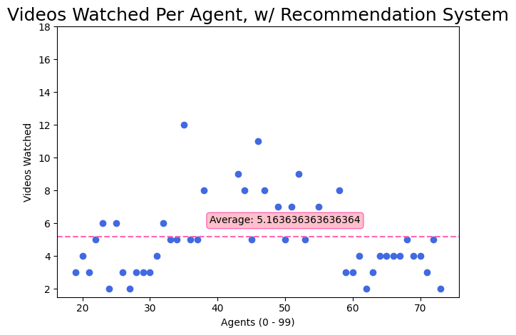
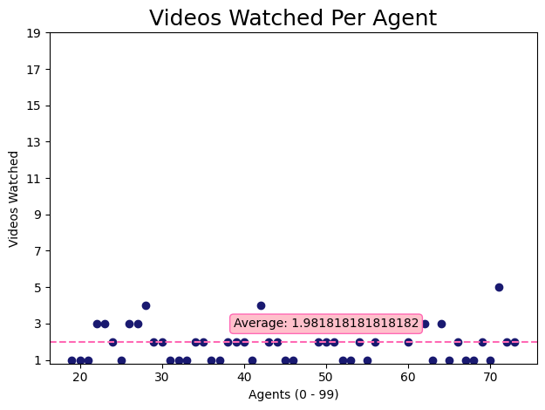
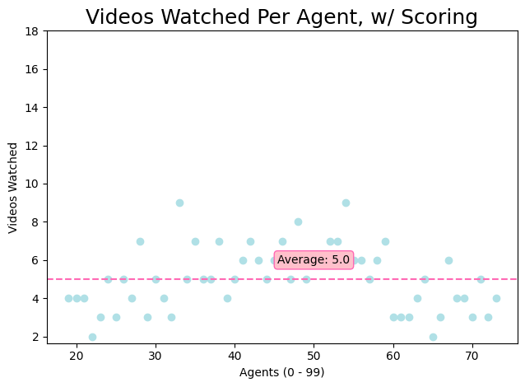
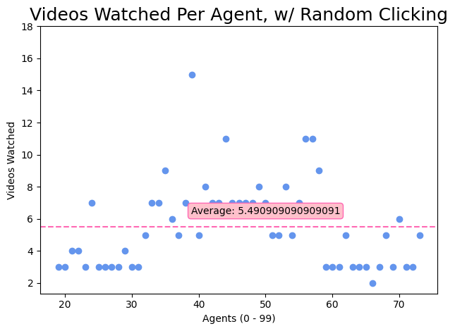
Middle Agents # of Videos Watched

Slide 21
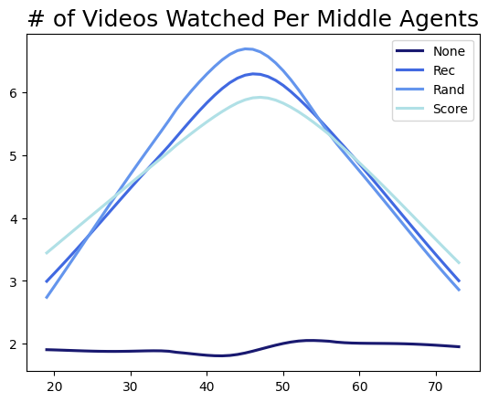
Videos Watched Cont’d.
No system: 1.98 videos
Filtered list system: 5.16 videos
Filtered list w/ random clicking: 5.49 videos
Scoring system: 5.00 videos
This also mirrors what we saw before; all the rec systems make users watch a higher quantity of videos, despite the videos being shorter.

Slide 22
Meeting 1/24/24

Slide 23
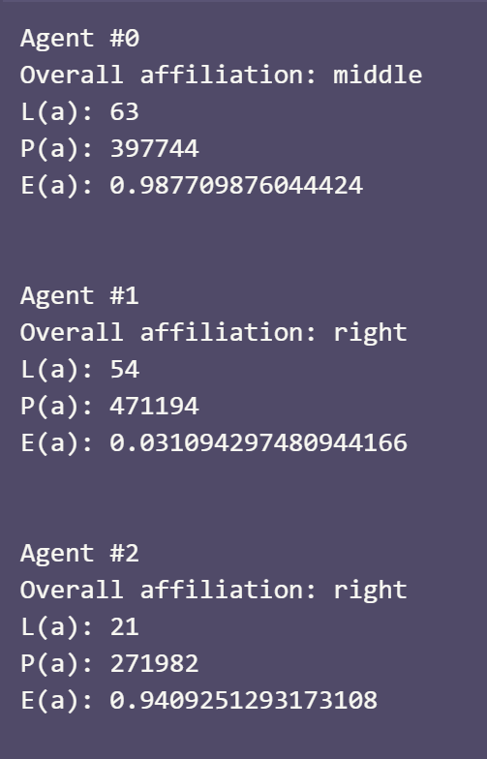
What did I do?
Generate all agents to have completely random attributes
Run the same graphs as before (plus one more, just sorted by agent extremeness) with random agents for the normal and scoring systems.
Unlike before, agent # doesn’t correlate in any way to the agent’s extremeness, so having the x-axis be individual agent # doesn’t tell us anything about trends.

Slide 24
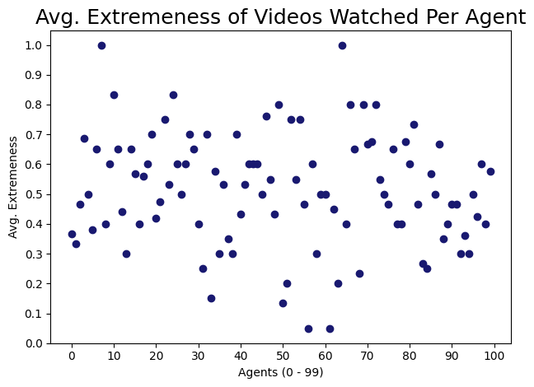
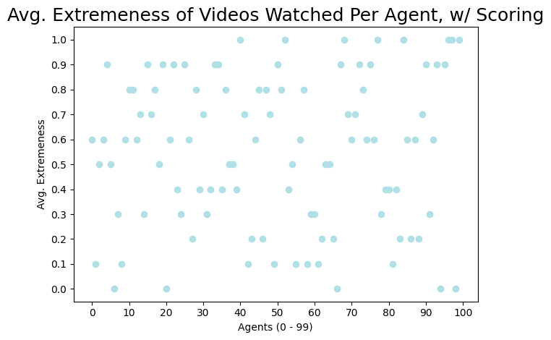

Slide 25
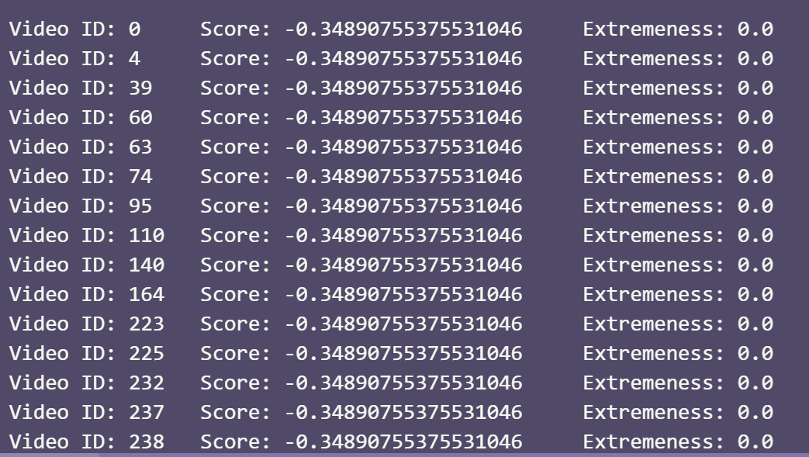
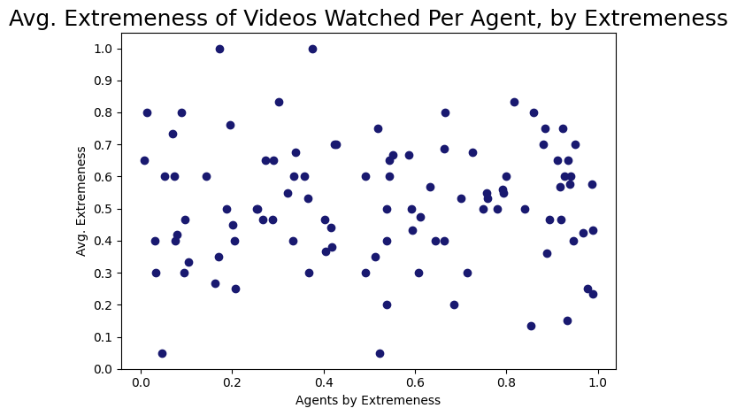
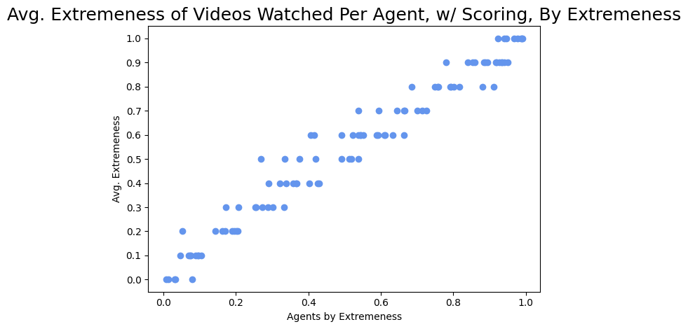
Why the horizontal lines? Why no trend on the left?
I think it’s because in the scoring, the first large amount of videos all have the same extremeness, and video extremeness-es are NOT random floats. Rather, they’re all picked from [0.0, 0.1, 0.2, 0.3, 0.4, 0.5, 0.6, 0.7, 0.8, 0.9, 1.0]
Maybe relax the strength of extremeness perefence in the scoring system so people watch a greater variety of extremenesses
Look at that trend line!

Slide 26
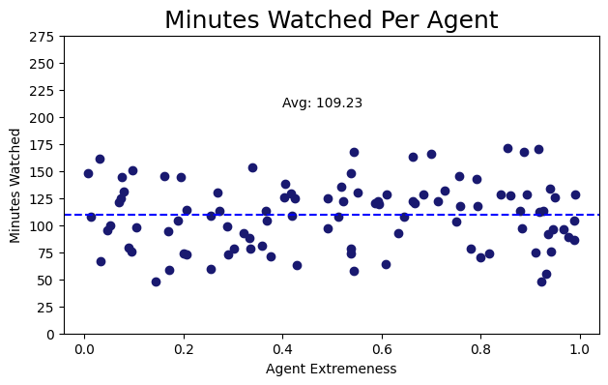
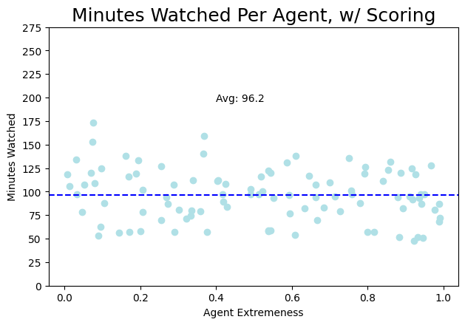
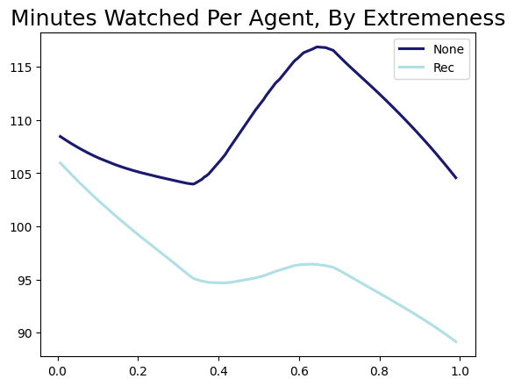
By Extremeness
Why does the average go down? Why is there no stratification on the extremes? i.e. shouldn’t the people on the extremes be watching longer videos, as is their preference? Or does this preference no longer exist, since it was tied to archetypes (where more extreme watching archetype == longer videos will be watched)? The stratification shows up I believe in the graphs w/ archetypes.

Slide 27
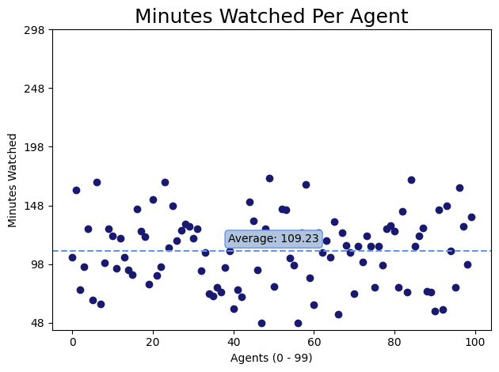
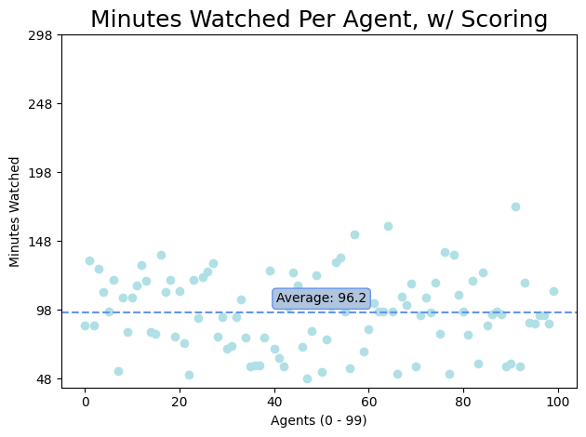
(same averages/values as the previous slide, just sorted by agent and not extremeness. which is why it looks more random.)

Slide 28
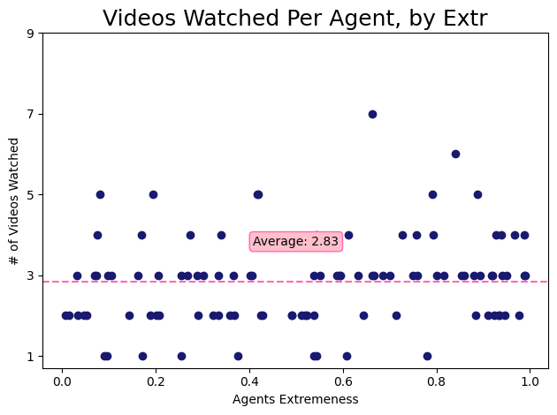
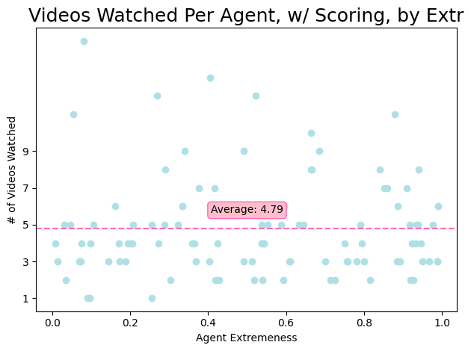

Slide 29
Comparing across archetypes and scoring/non-scoring
w/ Archetypes
w/out Archetypes
Variable (Averages)
Normal
Scoring
Normal
Scoring
Minutes watched (per agent)
92.12
85.13
109.23
96.2
Videos watched (per agent)
2.37
4.23
2.83
4.79
Extremeness of videos watched (overall)
0.475
0.503
0.518
0.5578
Without archetypes, all the values go up---the amount of minutes watched, # of videos watched, and average extremeness of all the videos watched.
Without archetypes, the average extremeness goes up slightly, the number of videos watched nearly doubles, and the number of minutes watched goes down. The same pattern happens with archetypes.
TODO: which is happening---is the simulation perfectly modeling irl, especially with the decrease in minutes watched? Or are there exclusions and assumptions being made that are leading to this? Figure it out.
The model said xyz---should I believe it? Is that part of the model I should change? Or am I learning something new?
I tried looking around a bit for the decrease in minutes watched, and maybe it’s modeling something like YouTube Shorts? Where they’re watching more of them, but they’re shorter videos (therefore it’s possible to watch more of them in a smaller amount of time)? Am I reinventing the YouTube Shorts wheel here?
Is there something in the scoring formula that makes people want shorter videos?
Be more precise---try to explain what the algorithm does in more precise terms. This outcome happens because the alogirthm does xyz mathematical thing that leads to abc. As opposed to arguments like “people like to watch shorter videos,” which may be true, but has to be represented in the code if you’re saying that.

Slide 30
Meeting 2/5/24

Slide 31
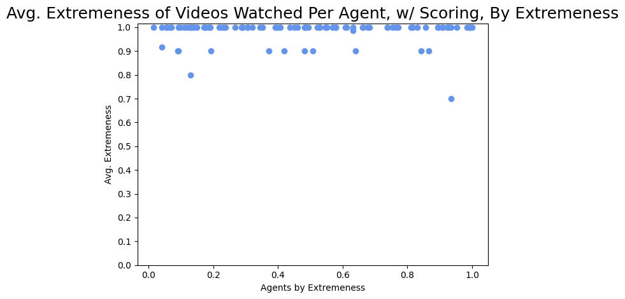
Messing Around w/ the Scoring Function (goal: try and loosen the restrictions to avoid the step-function-looking result.)
Original
alpha = 0.2 video length
beta = 0.15 video popularity
gamma = 0.5 video alignment delta = 0.15 video extremeness
Here
alpha = 0.3 video length
beta = 0.3 video popularity
gamma = 0.1 video alignment delta = 0.3 video extremeness

Slide 32
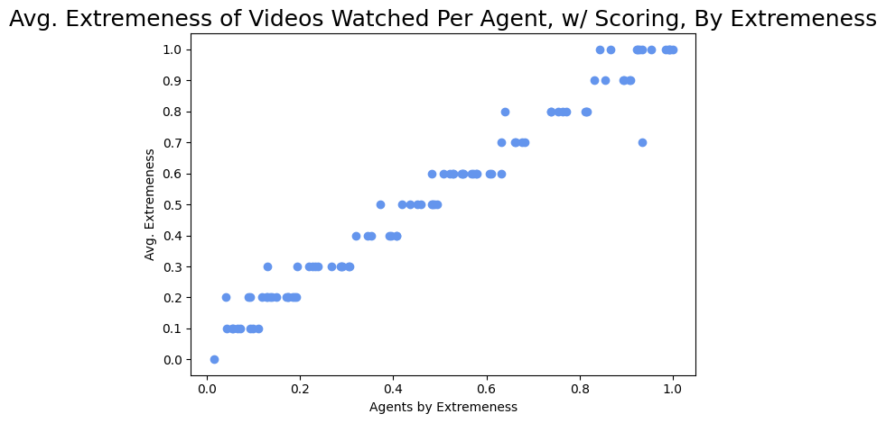
Messing Around w/ the Scoring Function (goal: try and loosen the restrictions to avoid the step-function-looking result.)
Original
alpha = 0.2 video length
beta = 0.15 video popularity
gamma = 0.5 video alignment delta = 0.15 video extremeness
Here
alpha = 0.2 video length
beta = 0.3 video popularity
gamma = 0.2 video alignment delta = 0.2 video extremeness

Slide 33
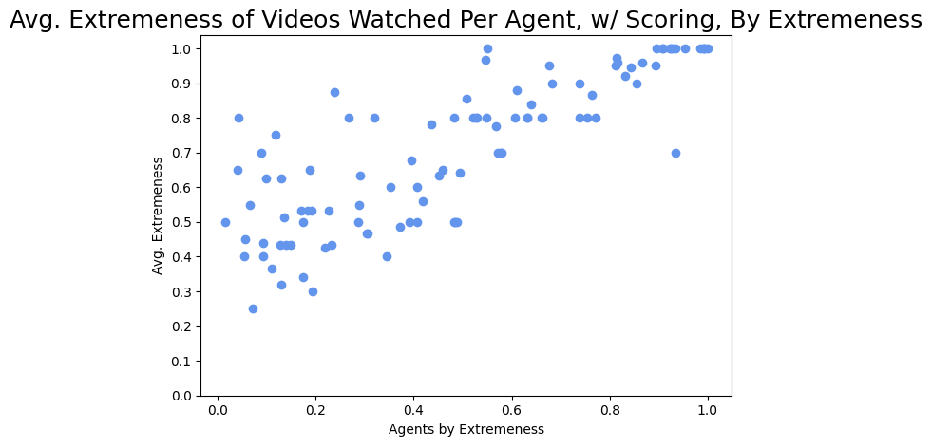
Messing Around w/ the Scoring Function (goal: try and loosen the restrictions to avoid the step-function-looking result.)
Original
alpha = 0.2 video length
beta = 0.15 video popularity
gamma = 0.5 video alignment delta = 0.15 video extremeness
Here
alpha = 0.4 video length
beta = 0.4 video popularity
gamma = 0.1 video alignment delta = 0.1 video extremeness
Todo: Make sure delta rewards being at the extremes, not close to 1

Slide 34
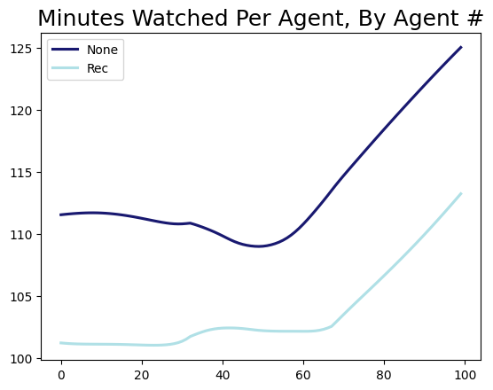
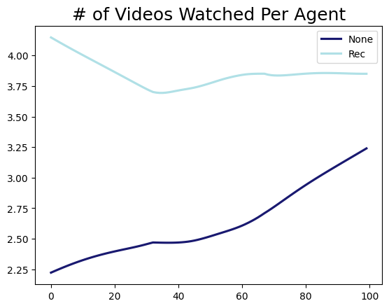
Continuing on This Particular Scenario (goal: try and loosen the restrictions to avoid the step-function-looking result.)
The same pattern of watching less minutes, but a higher number of videos, continues here, even with a much larger emphasis on video length (and popularity).
Todo: in the top graph, the light blue line should theoretically be about the same because users are watching until their time limit is exhausted
Here
alpha = 0.4 video length
beta = 0.4 video popularity
gamma = 0.1 video alignment delta = 0.1 video extremeness

Slide 35
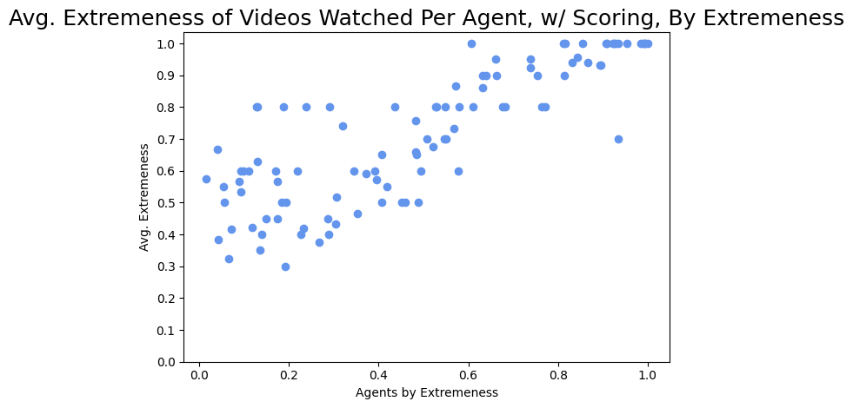
Expanding on the Last Slide What if we really bump the influence of video length?
The baseline extremeness shifts---in this scenario, it means the average video watched is more right-wing.
Why? I’m unsure.
Here
alpha = 0.7 video length
beta = 0.1 video popularity
gamma = 0.1 video alignment delta = 0.1 video extremeness

Slide 36
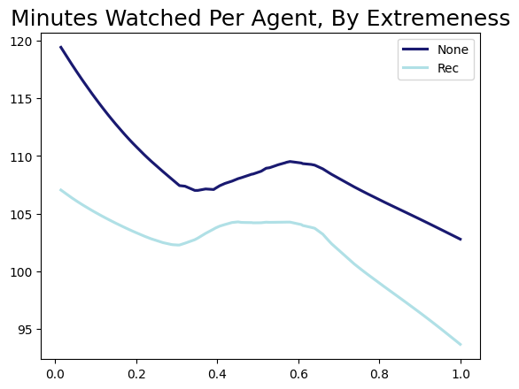
Expanding on the Last Slide What if we really bump the influence of video length?
However, the amount of minutes watched gets closer (no scoring = avg of 108.98, scoring = avg of 103.12).
Here
alpha = 0.7 video length
beta = 0.1 video popularity
gamma = 0.1 video alignment delta = 0.1 video extremeness

Slide 37
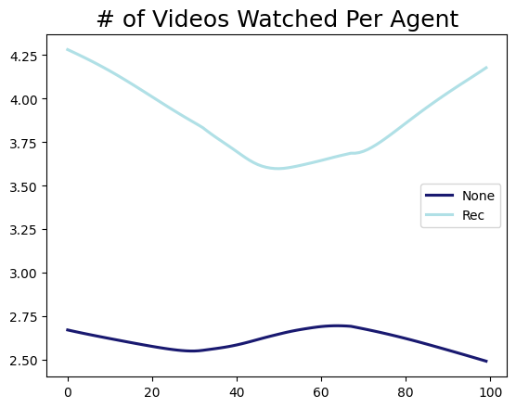
Expanding on the Last Slide What if we really bump the influence of video length?
The # of videos watched still stays nearly the same, but get a LITTLE closer (4.23 videos watched with scoring vs. 2.8 watched without).
Here
alpha = 0.7 video length
beta = 0.1 video popularity
gamma = 0.1 video alignment delta = 0.1 video extremeness

Slide 38
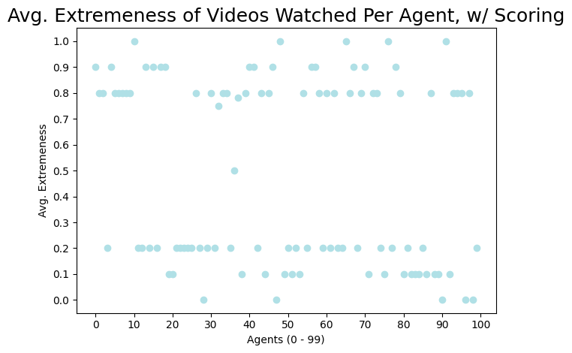
Oh, Dear
Todo: Make sure delta rewards being at the extremes, not close to 1
if((ev <= 0.2) or (ev >= 0.8)):
e_return = 1
else:
e_return = 0
Make delta the value that’s getting manipulated, not e_return
Make 0.2 and 0.8 parameters/vars that you can change, not hardcoded

Slide 39
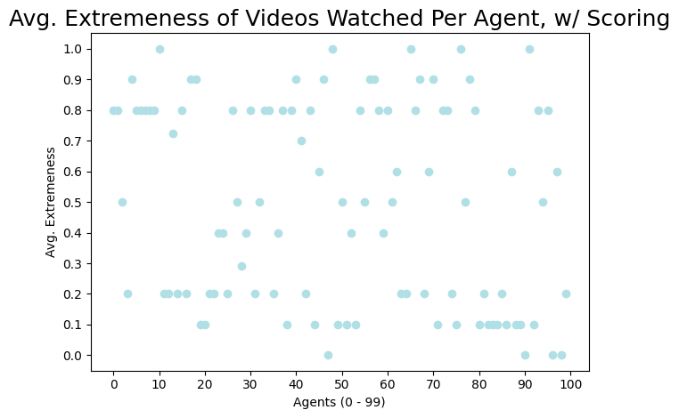
Oh, Dear
Todo: Make sure delta rewards being at the extremes, not close to 1
if((ev <= 0.2) or (ev >= 0.8)):
e_return = 0.5
else:
e_return = 0

Slide 40
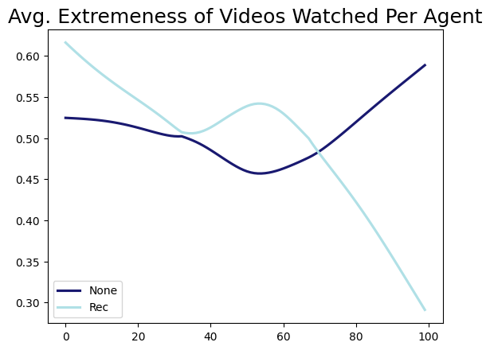
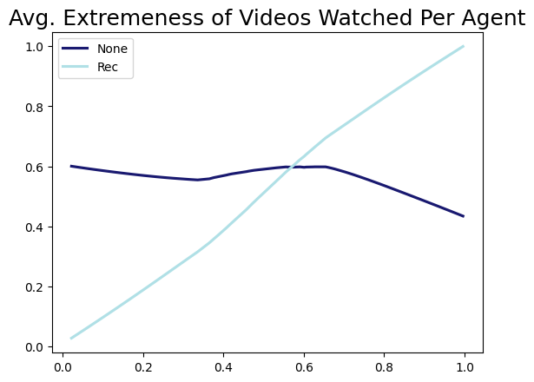
Left = no change, Right = rewarding extremes todo: in the rightgraph, dark bulue line, delta = 0. see what happens when you change delta. Do the same for all parameters send by Friday a list fo three more questions you can answer with a numerical experiment 1. Is it possible to reduce the emphasis on extremeness but keep total minutes watched approximately the same? Reduce emphasis on extremeness = change delta. Can these other weights be changed in order to reduce delta, ut keep people watching lots of videos?

